Slide 1
PROJECT DXC FORUM

Slide 2
INTRODUCTION
Objective: The main aim of DXC JAVA Capability Forum is to facilitate a user-friendly environment of Bluebook implementation and reduce the manual effort.
It provides meaningful real-time analysis, automatically displayed different bar graph and pie charts for different module.
DXC JAVA Capability Forum is a platform where we can upload excel sheets and generate charts and graphs.

Slide 3
MODULES & FUNCTIONALITIES
DXC Forum consists of various modules:
Dashboard
Mentoring
Certification
Training

Slide 4
TOOLS AND TECHNOLOGY
TOOLS
Eclipse
Visual Studio Code
Spring Tool Suite
DATABASE
MySQL
TECHNOLOGY
Front End
HTML and CSS
JavaScript
ReactJs
Bootstrap
Back End
JAVA
Spring Boot

Slide 5
PROJECT MEMBERS
FRONT END
Sanskar Goyal
Vikas NA
BACK END
Nagaveni E.
Sanskar Goyal
Satish Baldireddi
Sona Manoharan
Vikas NA
AWS
Satish Baldireddi
JENKINS
Nagaveni E.
Prachi Lepcha
JUnit
Venkatesh Selvam
SWAGGER
Sanskar Goyal
DOCUMENTATION
Prachi Lepcha
Vikas Kumar
Richa Goyal

Slide 6
MENTORS
GokulaKrishnan SethuRaman
Bharath P.
Supporting Mentor
Radhika Venkateswaralu Talapaneni

Slide 7
DETAILED ANALYSIS - TIMELINE
1 July – 15 July | 16 July – 31 July | 1 Aug – 15 Aug | 16 Aug – 23 Aug
Overview of Project Planned the project and recorded the technologies to be implemented. Distributed the tasks. | Completed creating the back-end for DXC Forum modules. Started working on front-end web pages. | Completed creating web pages for the DXC Forum. Successfully established the connection between front-end web pages and back-end. Design Documentation and UTR | Deployed the project into run-time environment with successful output. Deployed the project on AWS, Jenkins and Swagger. JUnit Test Project Support Guide

Slide 8
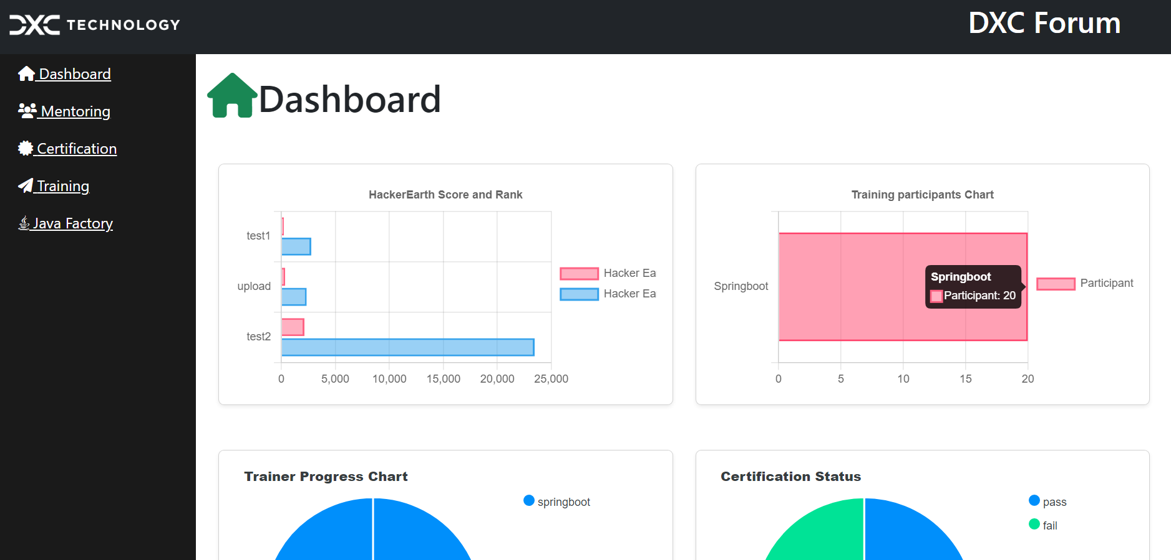
Dashboard Module

Slide 9
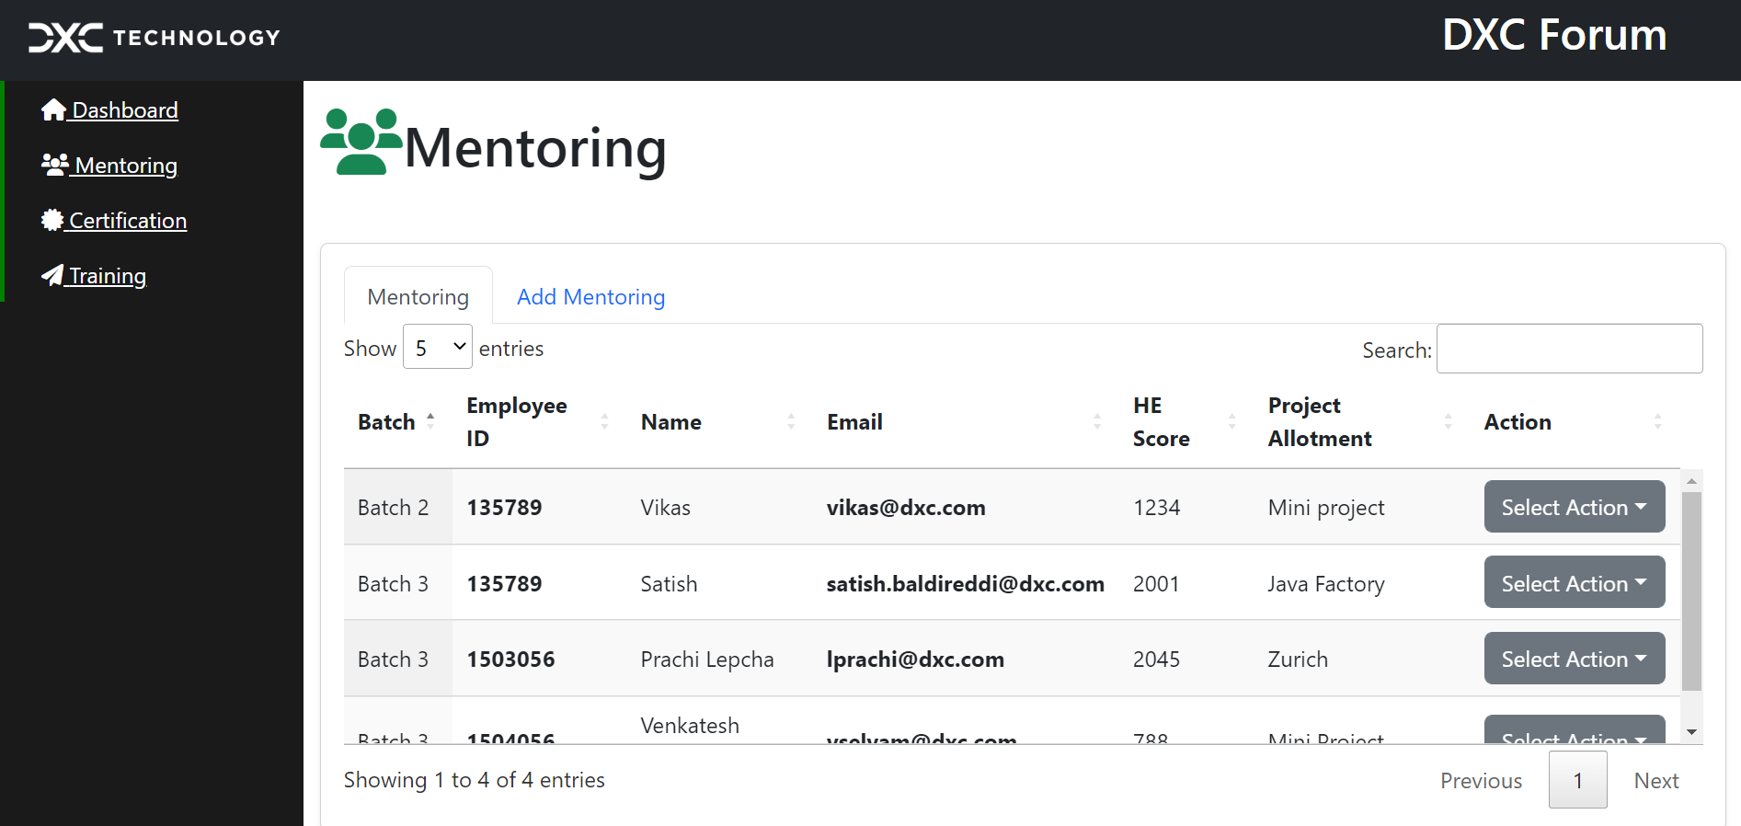
Mentoring Module

Slide 10
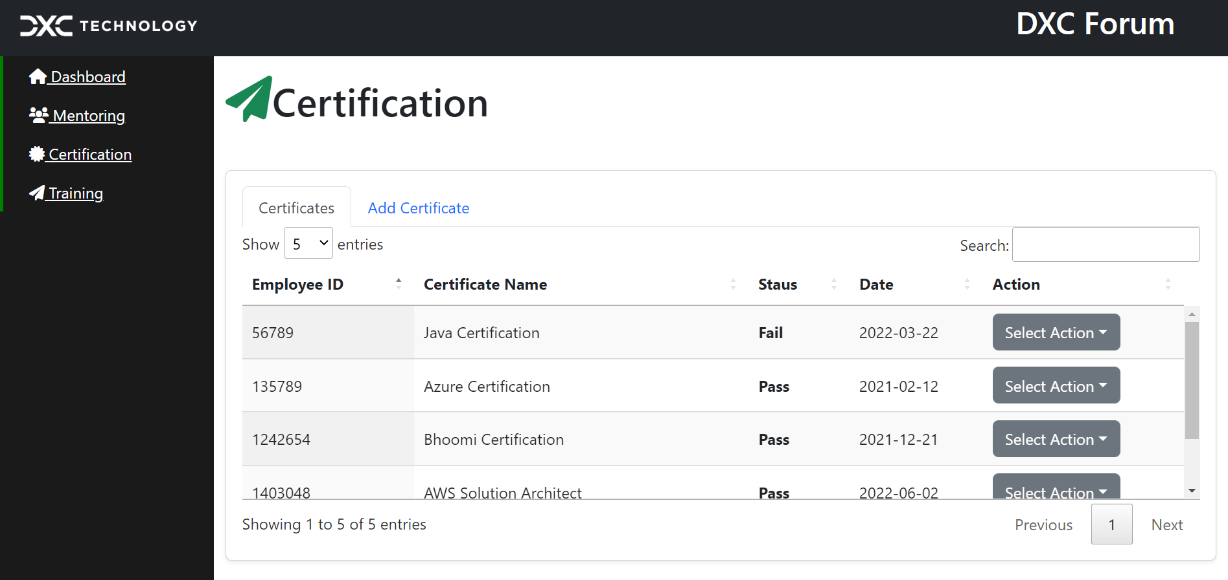
Certification Module

Slide 11
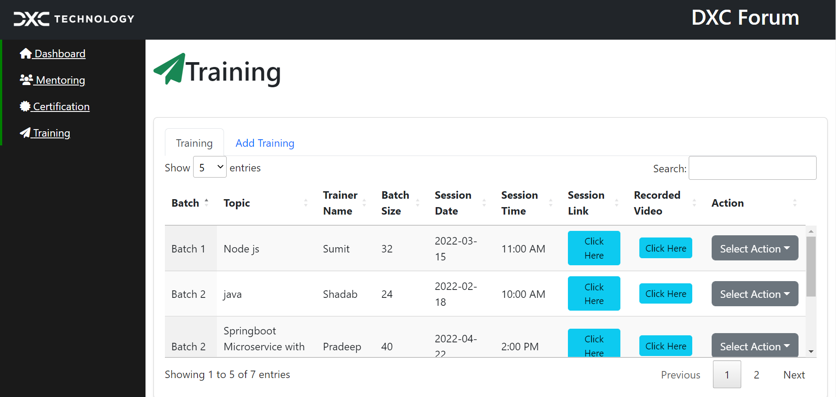
Training Module

Slide 12
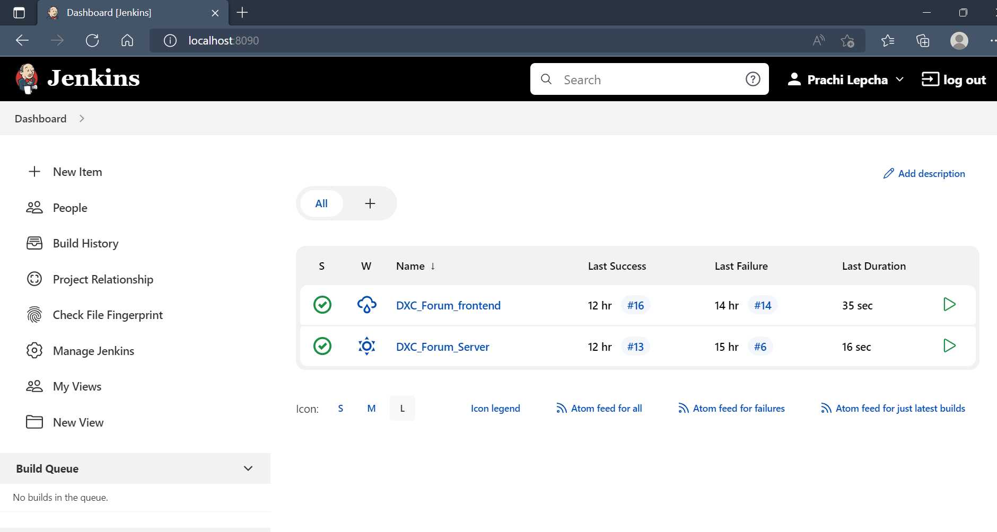
Localhost:8090 states that Jenkins server application is deployed.

Slide 13
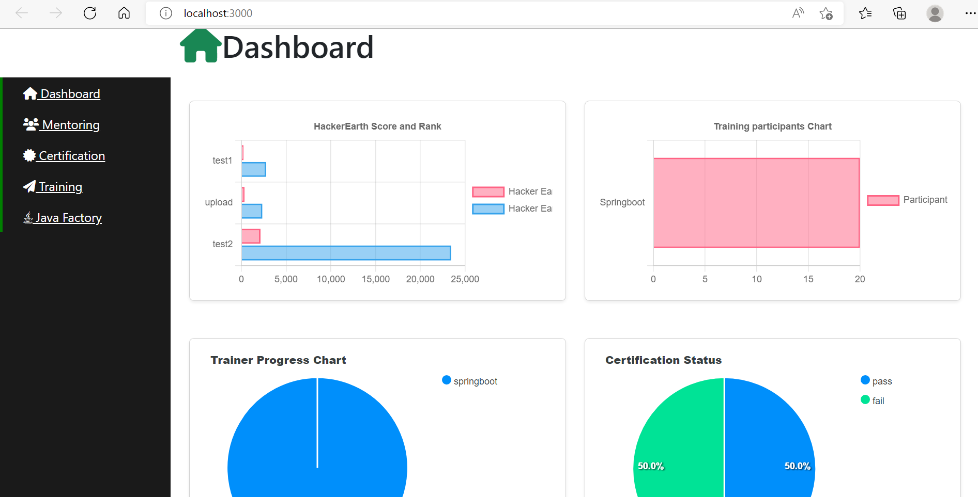
Application deployed in AWS
(dxcforum-client.s3-website.ap-south-1.amazonaws.com)

Slide 14
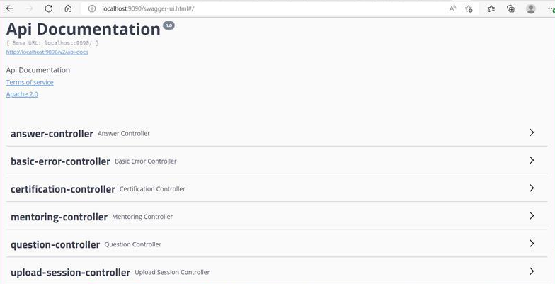
Swagger Deployment
(localhost:9090/swagger-ui.html)

Slide 15
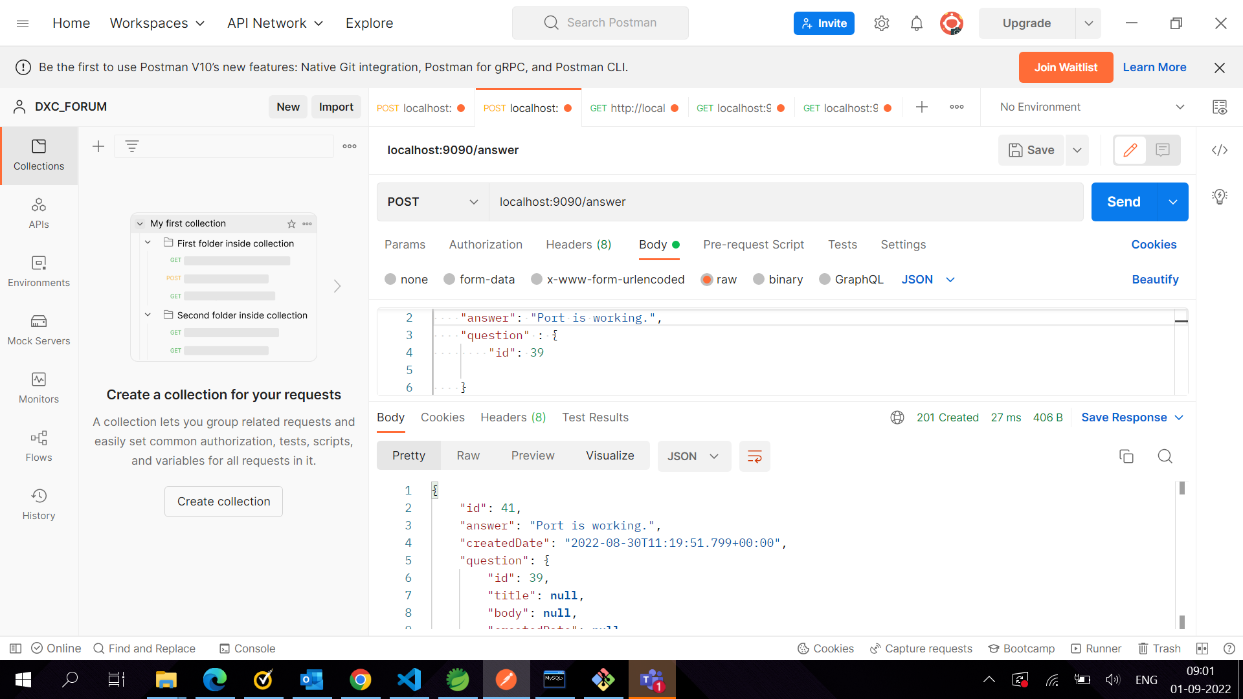
Postman

Slide 16
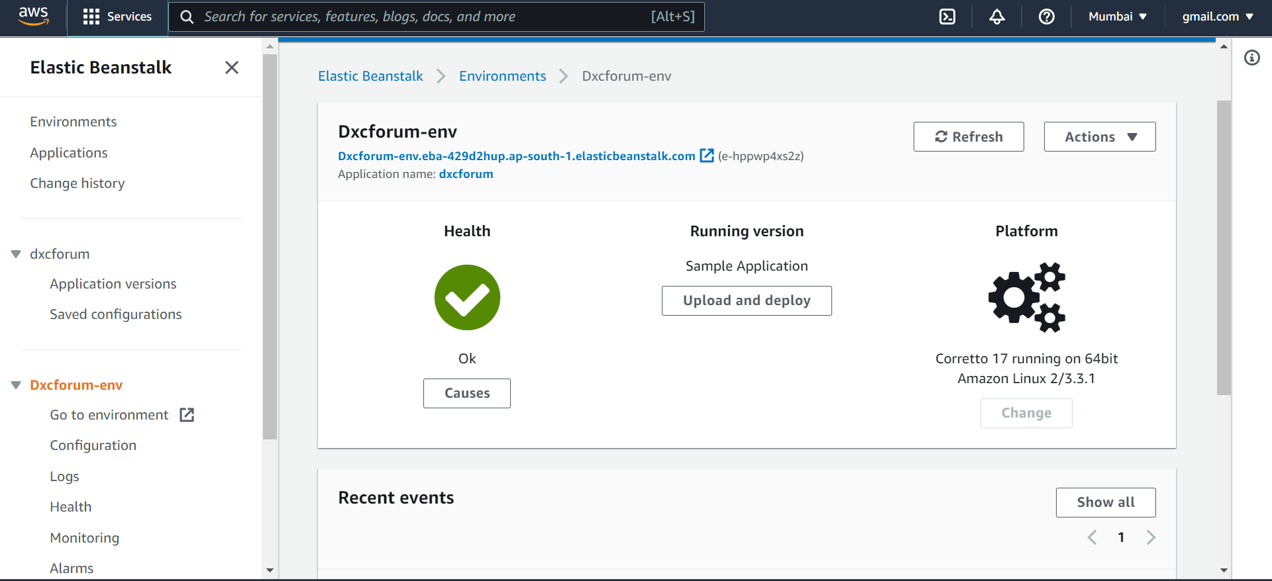
AWS

Slide 17
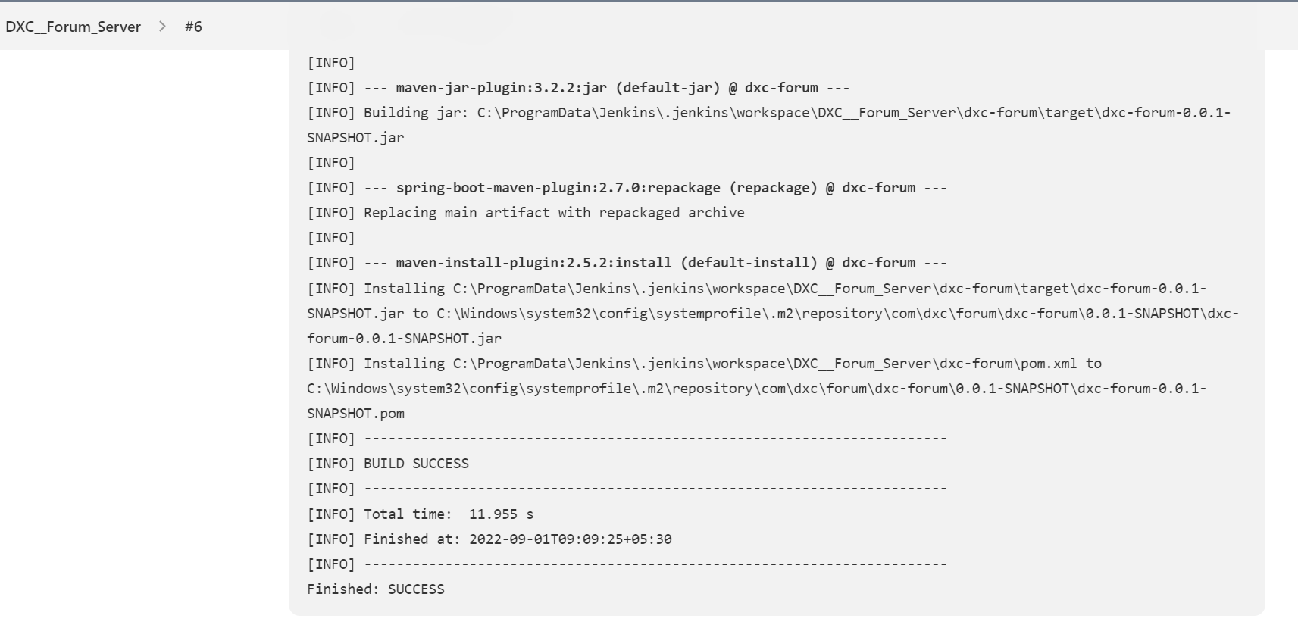
Jenkins

Slide 18
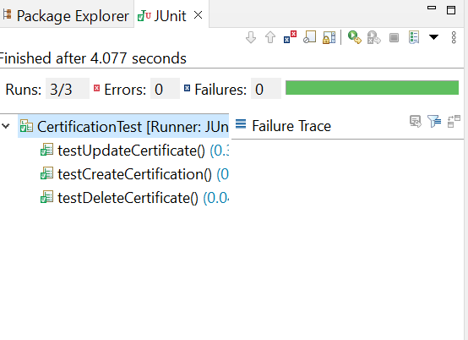
JUnit Test

Slide 19
DOCUMENTATION
Documents uploaded in DXC Git and DXC COE SharePoint
Project PPT
Unit Test Results
JUnit Test Report
Design Document
Jenkins PPT
AWS PPT
Project Support Guide

Slide 20
DOCUMENTATION
Documentations uploaded to DXC Git under documents repository:
DXC-Forum/documents
Documentation in DXC COE SharePoint: OnlineForum_DXC_JavaCapablity_Project
Project Support Guide: Uploaded in DXC Git and DXC COE SharePoint

Slide 21
UPCOMING ENHANCEMEMT
Code Review – SonarQube
JAVA consultancy support, RFP – New modules
JAVA Factory Module
Form Validation
Login Module

Slide 22
THINGS WE LEARNED
Technical Forum discussions
Public speaking- Toastmaster sessions
Status updates
Connecting with team
Call meetings
Team work- Project deployment

Slide 23
THANK YOU

